Slide 1


Complete ASIC Flow of I2C Communication Protocol
CND 211: Advanced Digital Design
BY: AhmedMoHAMED Elattar

Slide 2


Project Description:
I2C is a bi-directional serial bus that provides a simple and efficient method of data exchange between devices.
It is most suitable for applications requiring occasional communication over a short distance between many devices.
The I2C standard is a true multi-master bus including collision detection and arbitration that prevents data corruption if two or more masters attempt to control the bus simultaneously.
In this project, I will go through the ASIC flow to create the complete layout (GDS) of an I2C which is a two-wire, Using SAED90_EDK.

Slide 3
EDA Tools:
EDA Playground(synopsys VCS 2023.03)
Design Complier
Formality
IC Compiler II Library Manager
IC Compiler II
Prime Time

Slide 4
Flow Steps:
Synthesis of the RTL
Formal Verification
Performing static timing analysis
Creating the floorplan and power plan
Performing CTS
Placing and routing the core
Signoff and GDS export

Slide 5
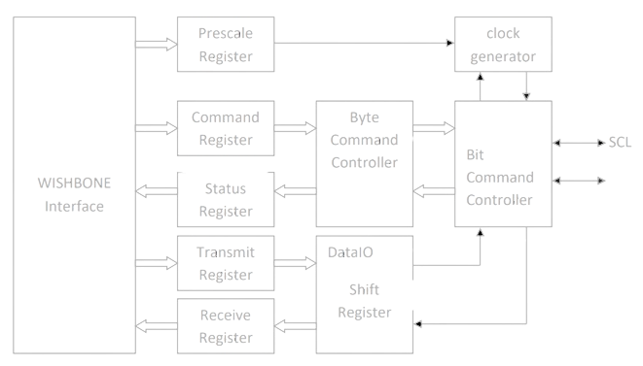
Internal structure of I2C Master

Slide 6
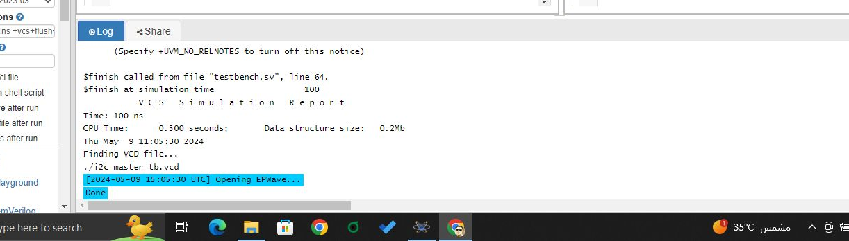
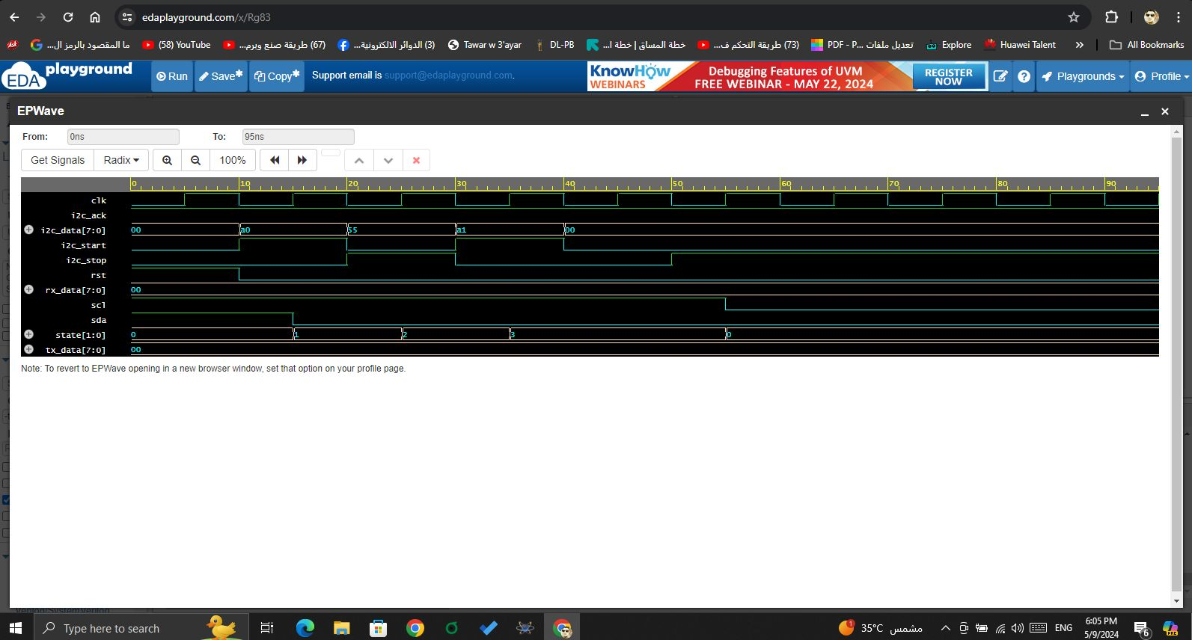
EDA Ep wave

Slide 7
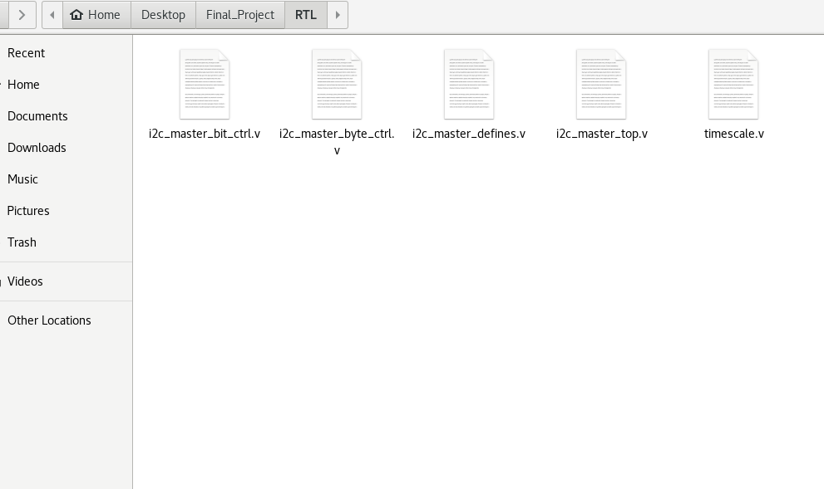
RTL

Slide 8
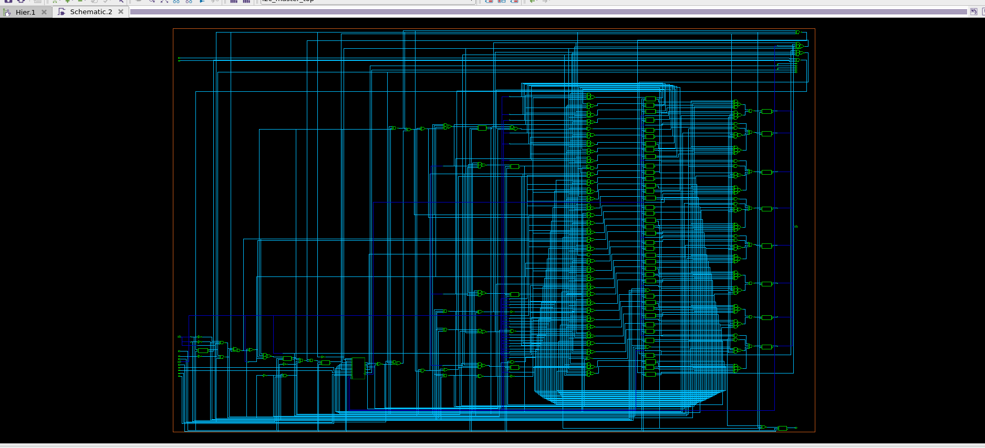
Netlist Synthesis

Slide 9
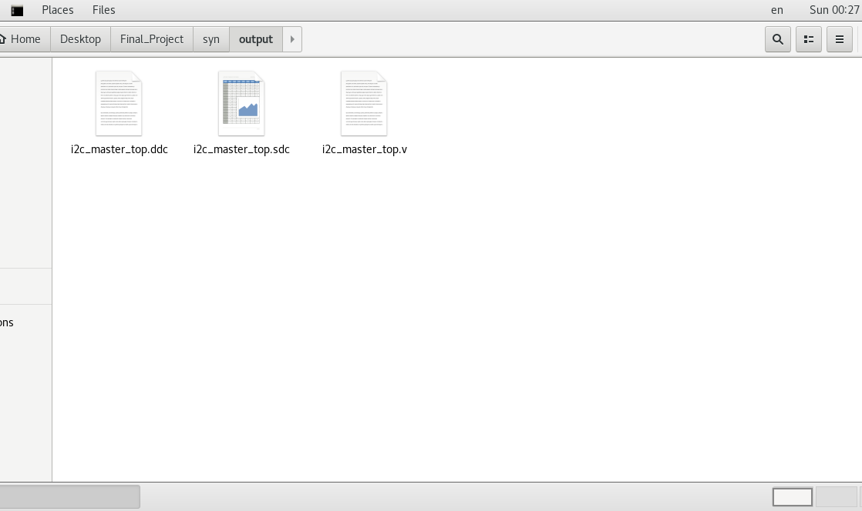
Synthesis Output Files

Slide 10
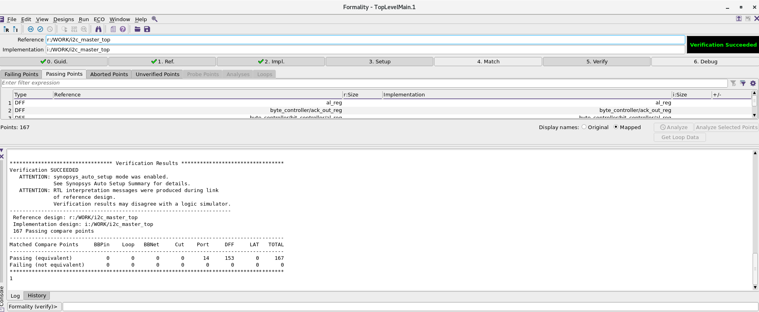
Formal Verification
Succeeded

Slide 11
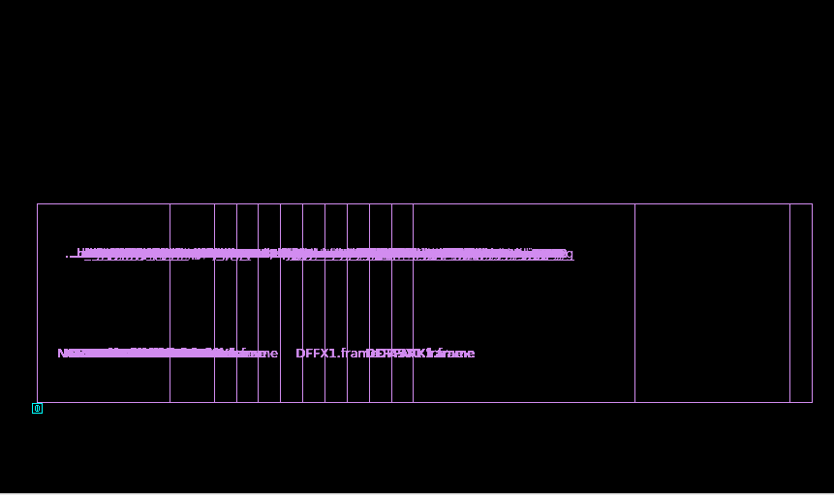
Floor planning before sizing

Slide 12
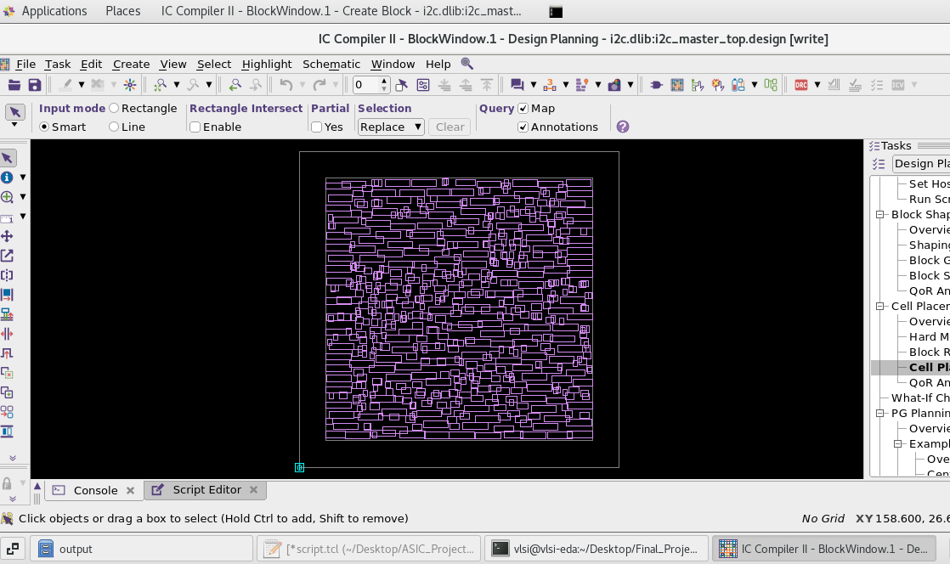
Initial Floor planning

Slide 13
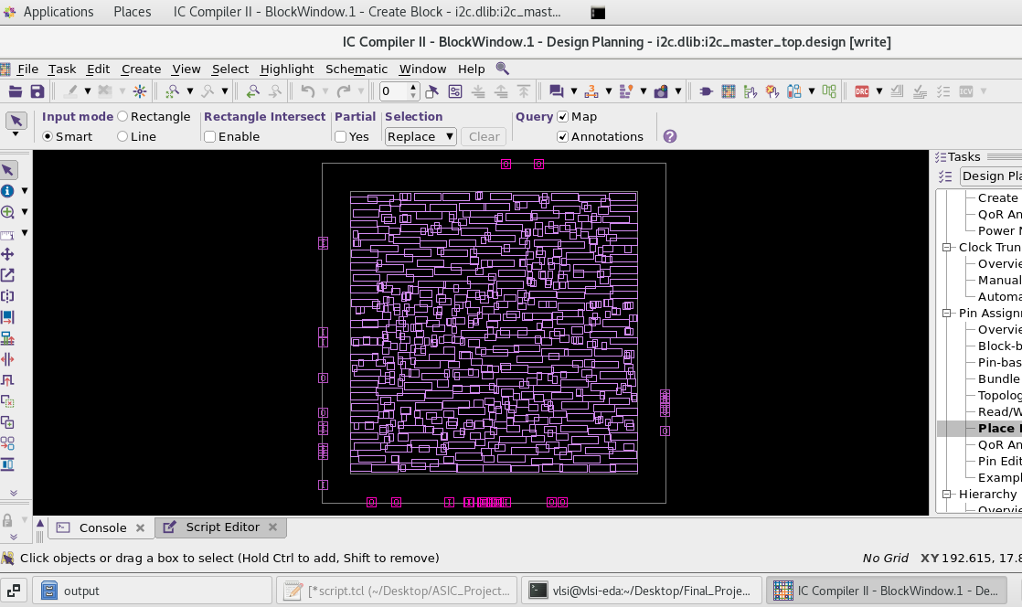
Pin Placement

Slide 14
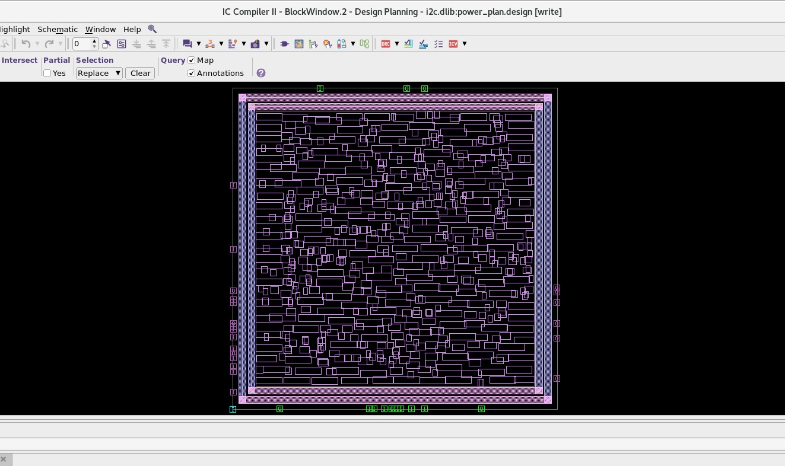
Power planning (Ring)

Slide 15
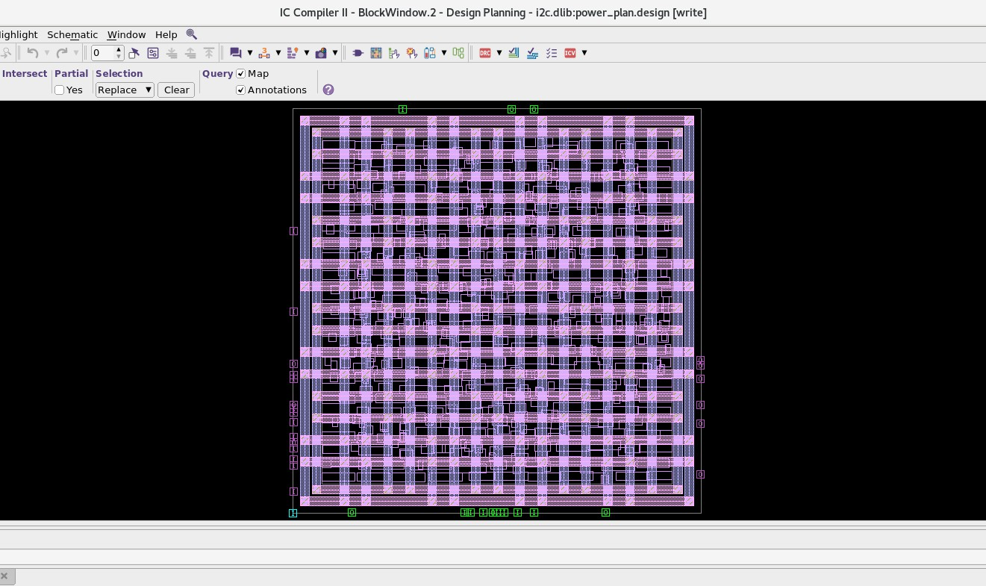
Power planning (Mesh)

Slide 16
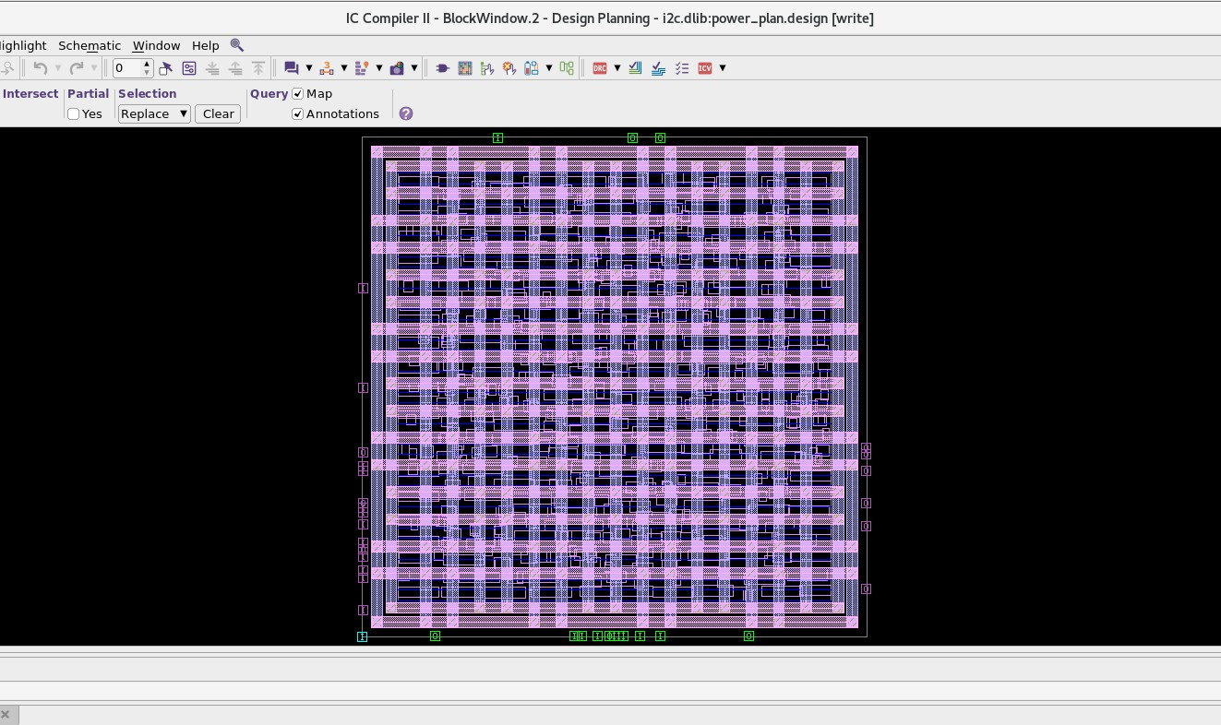
Power Planning after standard cell rail insertion

Slide 17
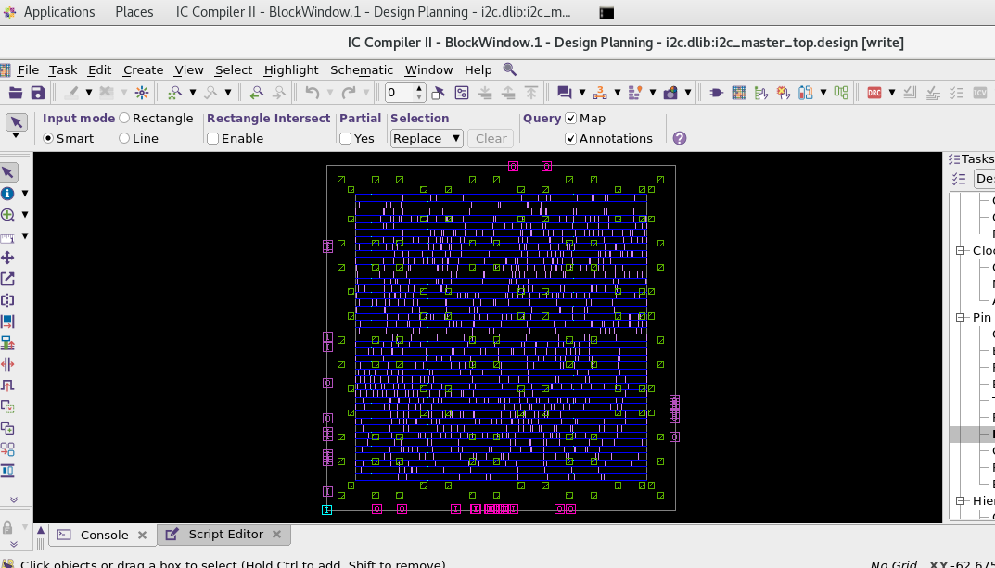
Cell Placement optimization with legalization

Slide 18
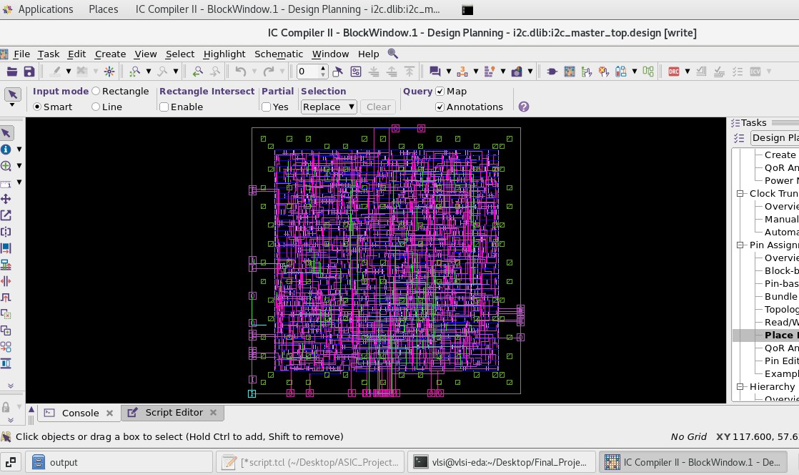
CTS (Clock Tree Synthesis)

Slide 19
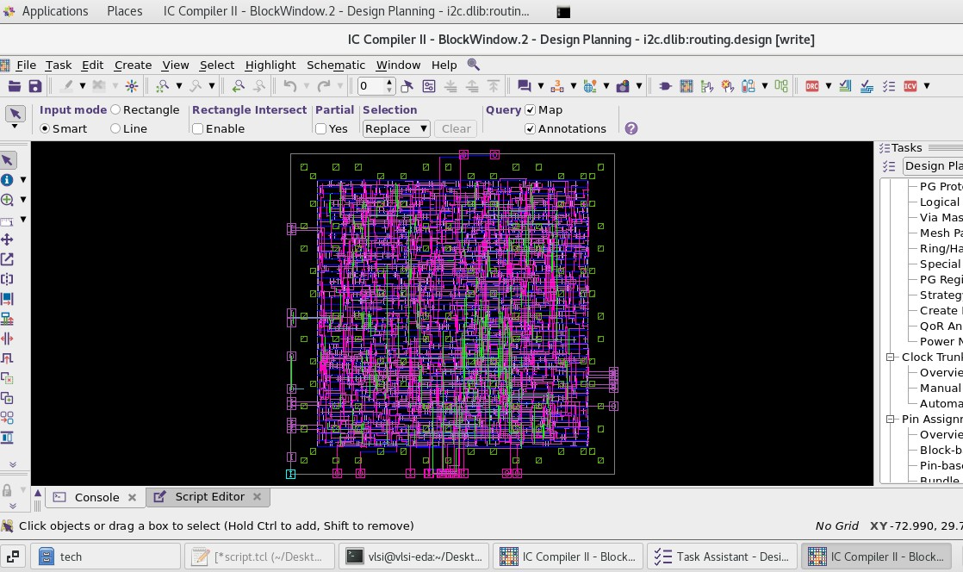
Routing Optimization

Slide 20
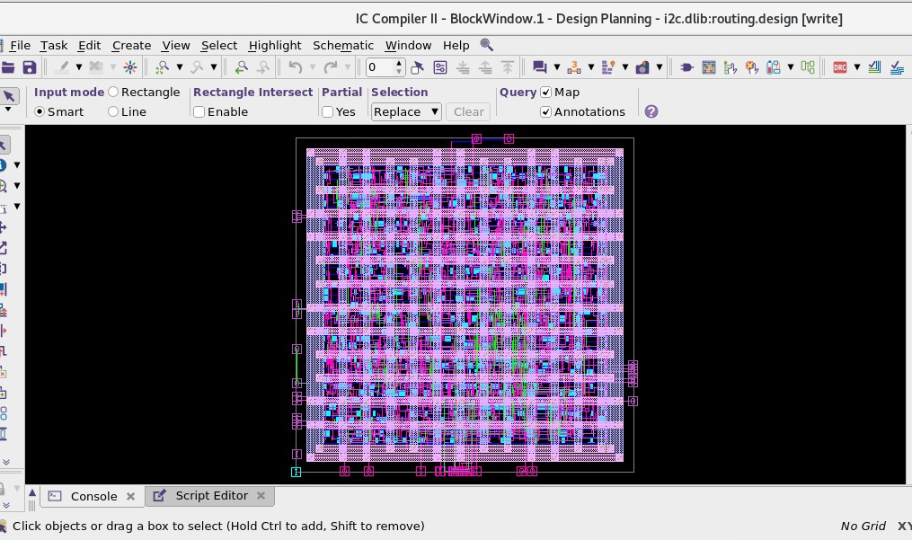
Adding Filler Cells

Slide 21
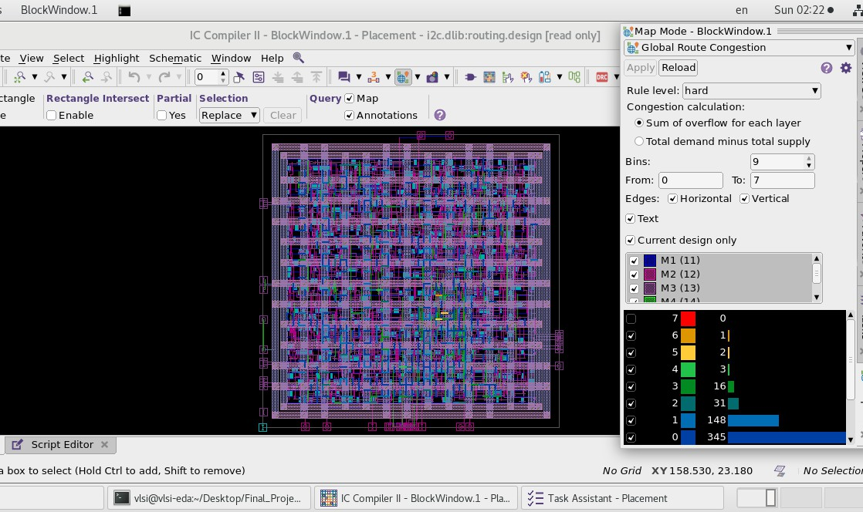
Global Route Congestion Map

Slide 22
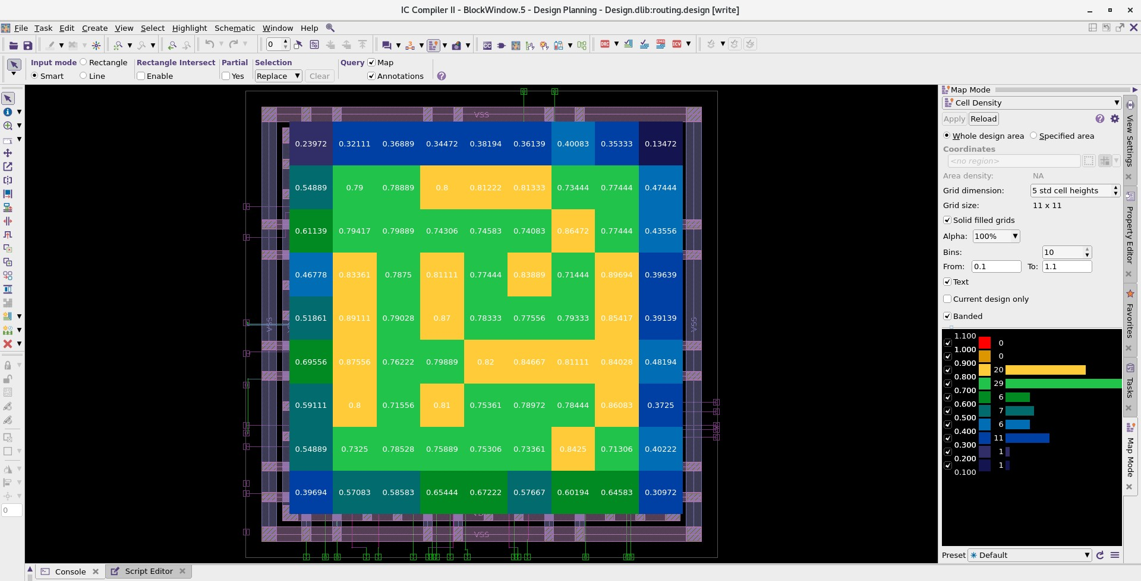
Cell Density

Slide 23
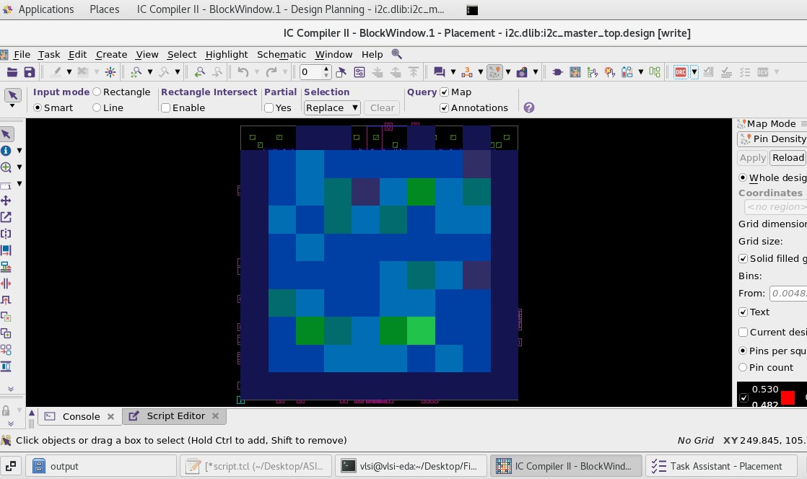
Pin Density

Slide 24
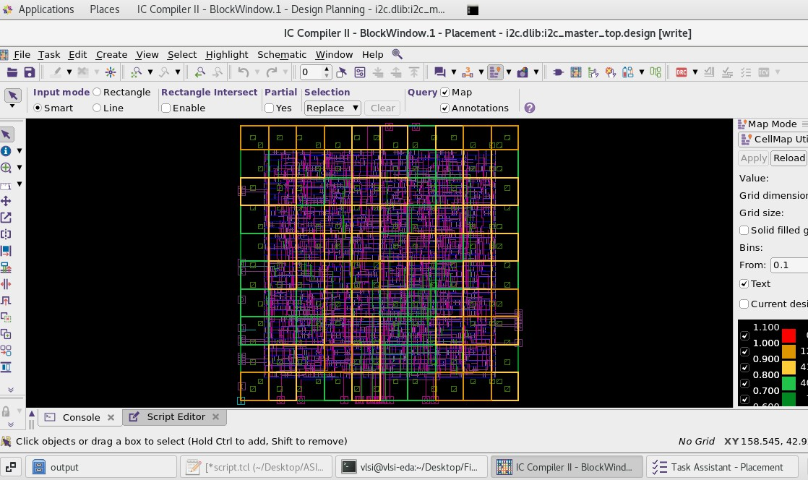
Cell Map Utilization

Slide 25
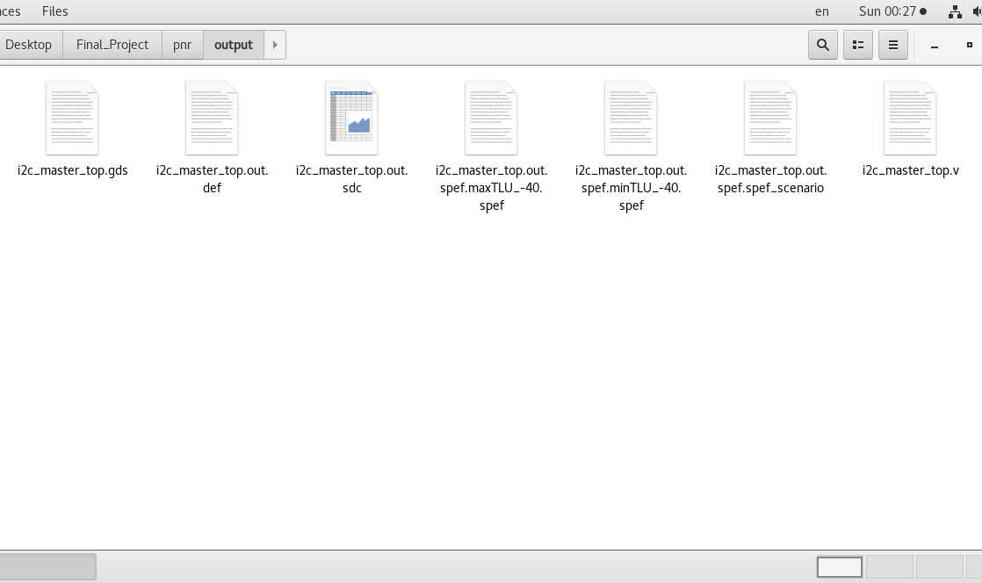
ICC II Output Files
GDS
Synopsys Design Constraints File

Slide 26
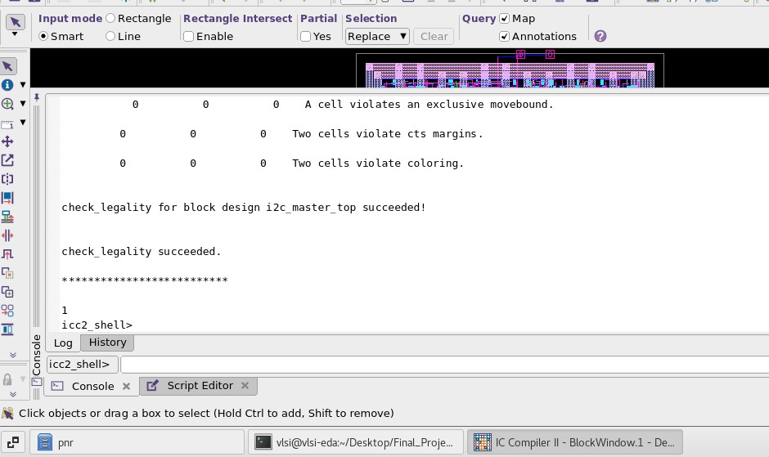
Check Legality succeeded

Slide 27
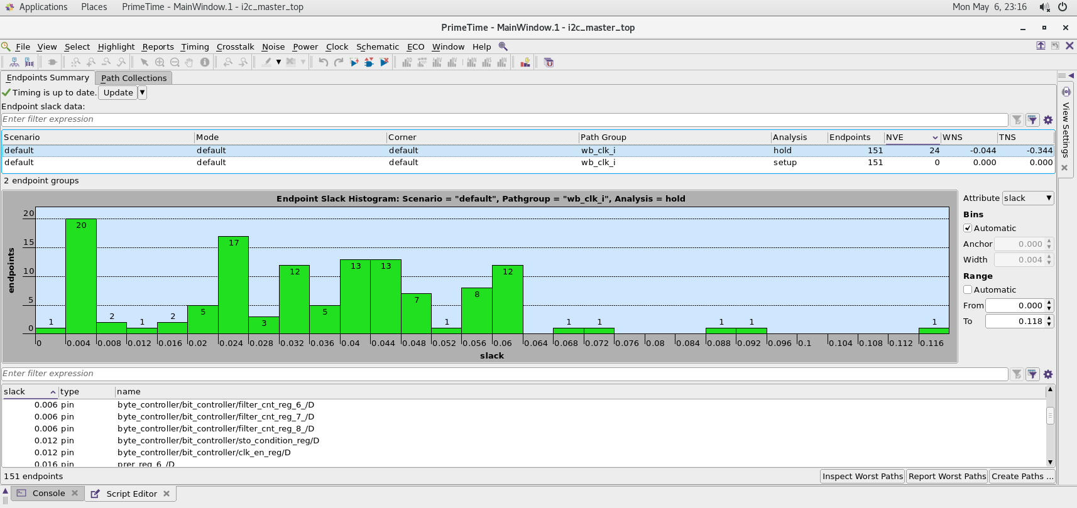
Primetime Histogram

Slide 28
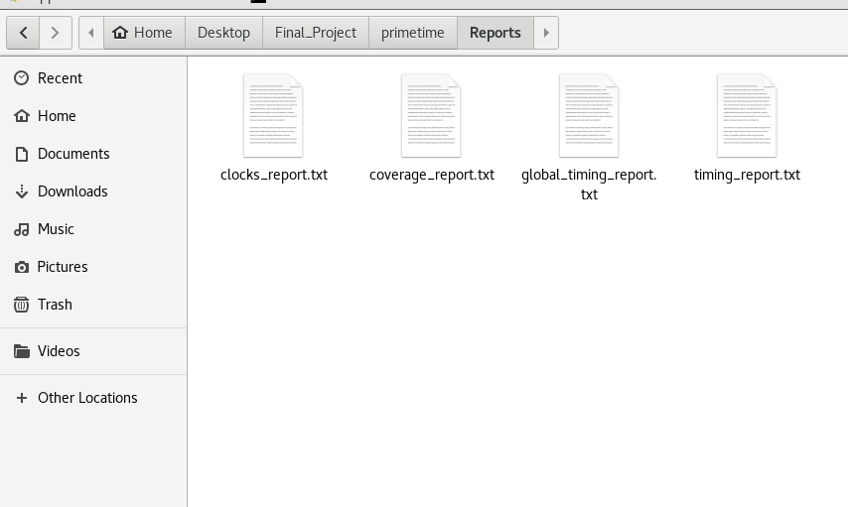
Primetime Reports

Slide 29
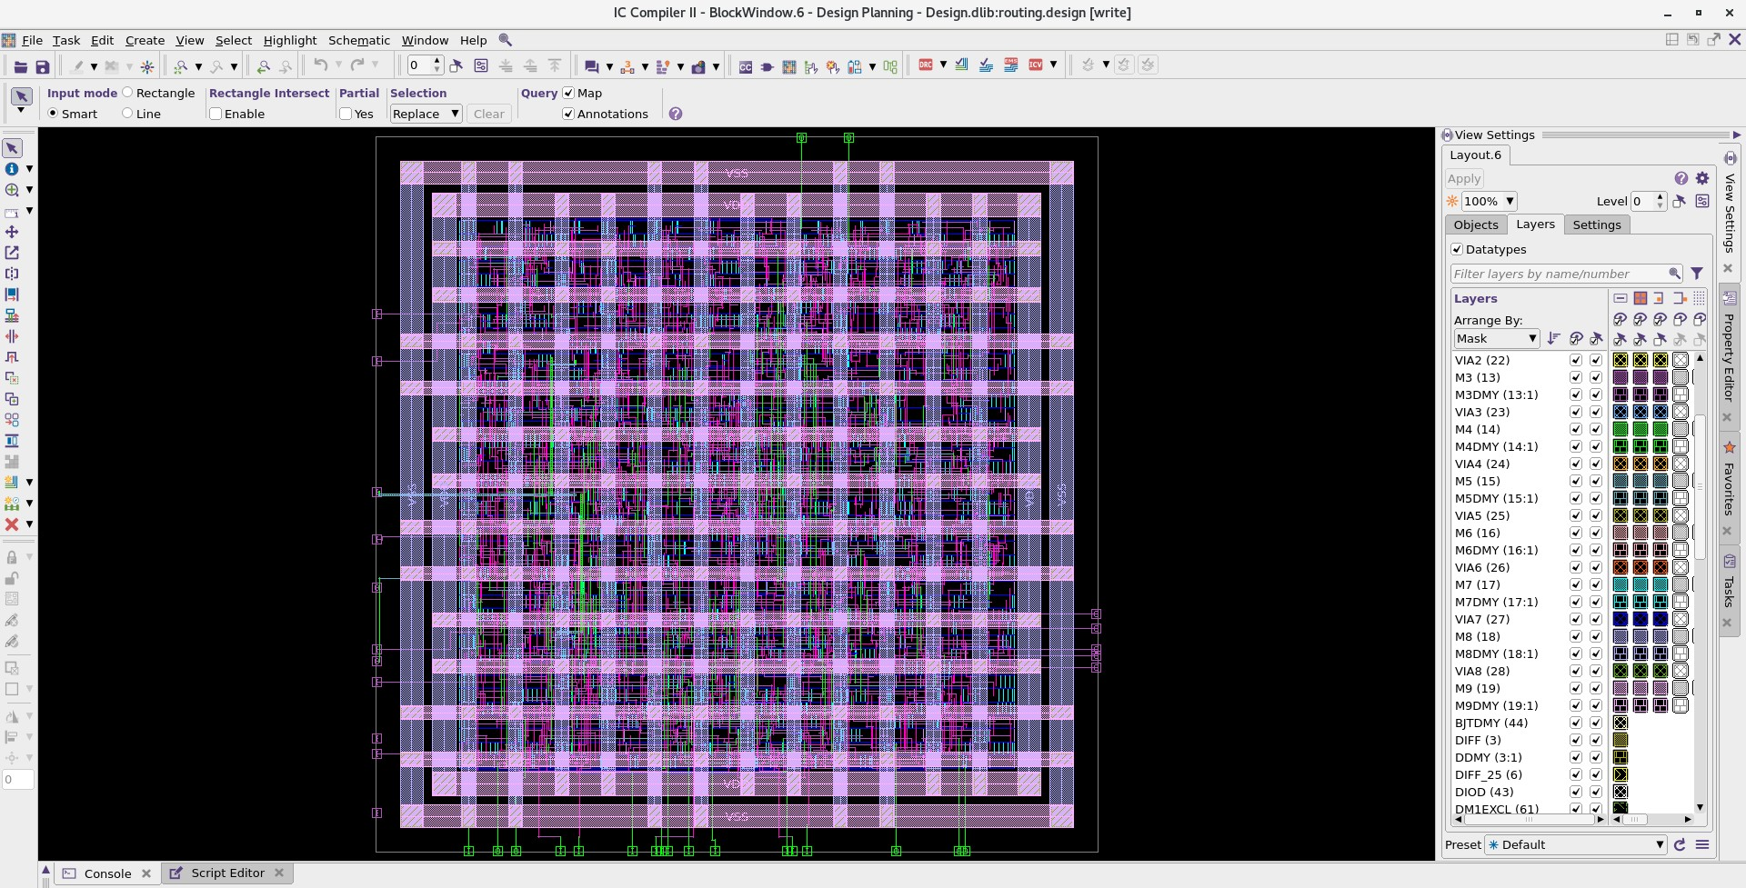
Final Layout View of the design

